Slide 1

TPS Reports for GIS in Python
Tasks, Problems, and Solutions: Python packages to help you get things done. Repeatedly.
Nick Santos
UC Davis Center for Watershed Sciences
#MaptimeDavis – 2/21/2018
https://www.liquidvpn.com/sidtoday-newsletter/

Slide 2
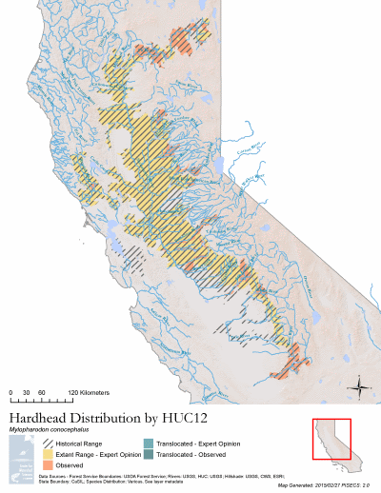
Task: We’re contracted to deliver hundreds of computer generated vector layers with metadata
* 500
Problem: There’s no good way to programmatically edit metadata from Python

Slide 3
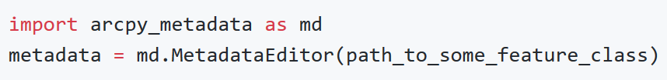
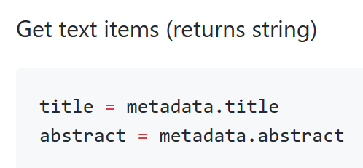
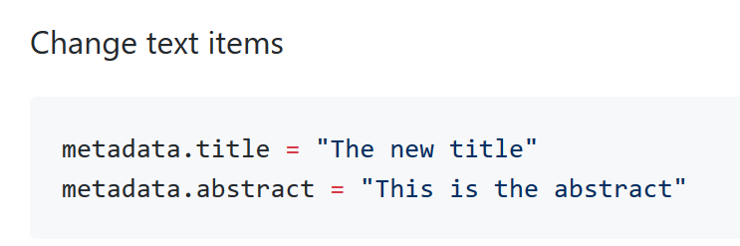
Solution: Develop our own library to allow editing metadata
Exports metadata to XML for editing and reads it
Edits XML so you don’t have to!
https://github.com/ucd-cws/arcpy_metadata, available on pip

Slide 4
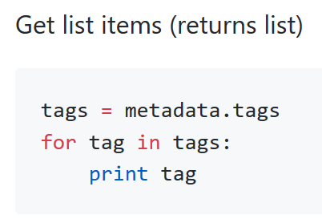
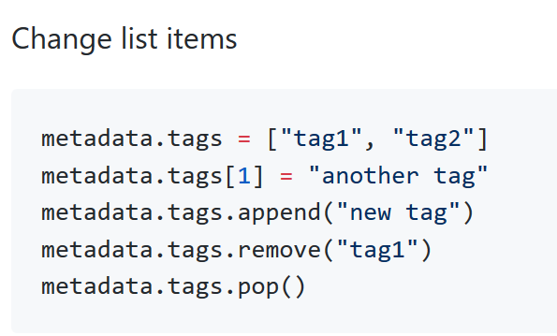
arcpy_metadata
Writes XML back as metadata!
Takeaway: Write metadata in normal Python!
https://github.com/ucd-cws/arcpy_metadata, available on pip

Slide 5
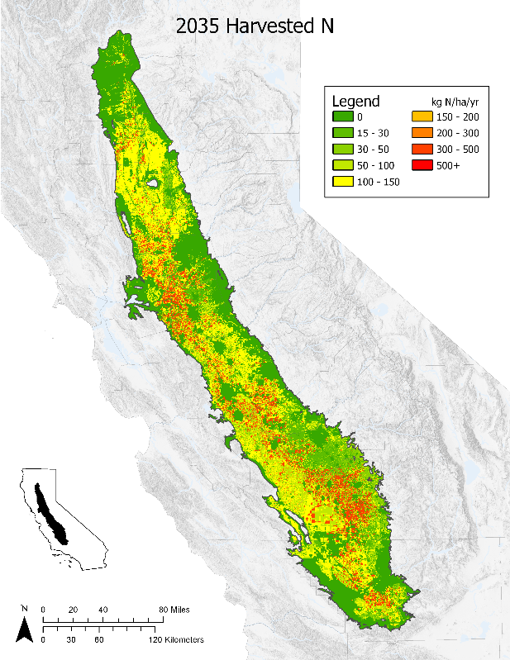
Task: We need to programmatically generate maps on demand in ArcGIS
* 150
Problem: We need this to work for many years – office is currently using ArcMap, but will probably switch to ArcGIS Pro where the mapping API has changed

Slide 6
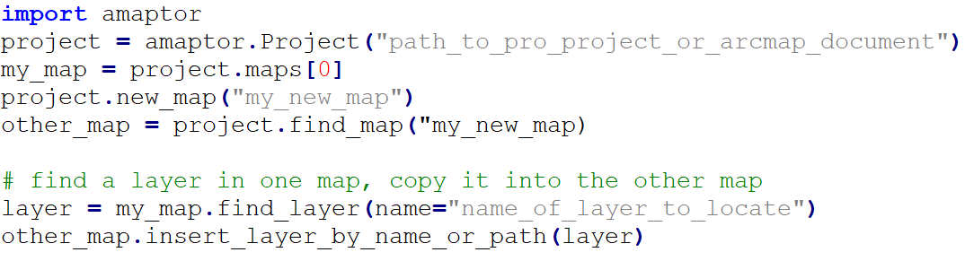
Solution: Develop a package that bridges the gap and creates a single unifying API (and has some other conveniences too)
Load an MXD or an ArcGIS Pro Project. Loading an MXD in Pro Python is OK!
Find a data frame or map by name or index. Can also do .active_map
In Pro, add more maps!
Manipulate layers in the map (or data frame!), add layers to maps, etc!
https://github.com/ucd-cws/amaptor, available on pip

Slide 7

Changed Title
Swapped out legend
Added raster and symbolized it with premade layer file
Set scale to match added raster
Exported PNG
https://github.com/ucd-cws/amaptor, available on pip

Slide 8
Task: We need a script that does some work in Python to interface with R
Problem: This code will be installed on many computers and it needs to just work – no configuration – across Windows and R versions.

Slide 9
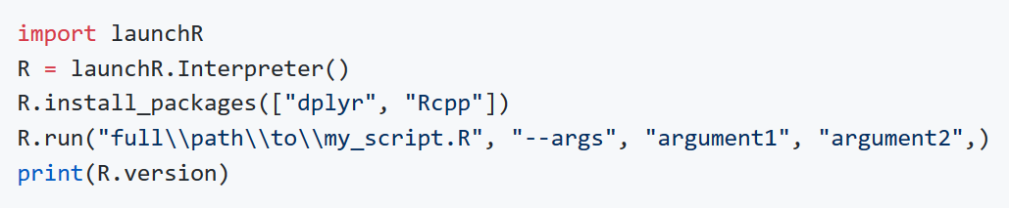
Solution: Make a Python package that finds and launches R
Finds R in the Windows registry – it doesn’t need to be on the PATH
Set up your environment before starting R
Call a script, pass it arguments!
Currently Windows-only. Code is simple – if you’d like to extend it to other platforms, get in touch and submit a pull request!
https://github.com/ucd-cws/launchr, available on pip

Slide 10

Acknowledgements and Followup
arcpy_metadata
github.com/ucd-cws/arcpy_metadata
Get In Touch
Nick Santos
UC Davis Center for Watershed Sciences
nrsantos@ucdavis.edu
http://nicksantos.com
Amaptor and LaunchR
github.com/ucd-cws/amaptor
github.com/ucd-cws/launchr
Thanks to
Thomas Maschler and the World Resources Institute
California Department of Fish and Wildlife
All contributors on GitHub
Andy Bell
John Durand
The State of California

